Slide 1
Socket Programming
Robert Benstine, Chris Cartaya

Slide 2
What is Socket Programming?
Socket Programming is a means of connecting two devices or nodes together over a network.
This system of communication typically uses a server-client communication model. Where the socket acts through a filesystem where processes can write onto another and vice-versa.
Multiple Processes can reach out to each other, creating a bi-direction facet of communication as file descriptors on a singular or multi-device network.

Slide 3
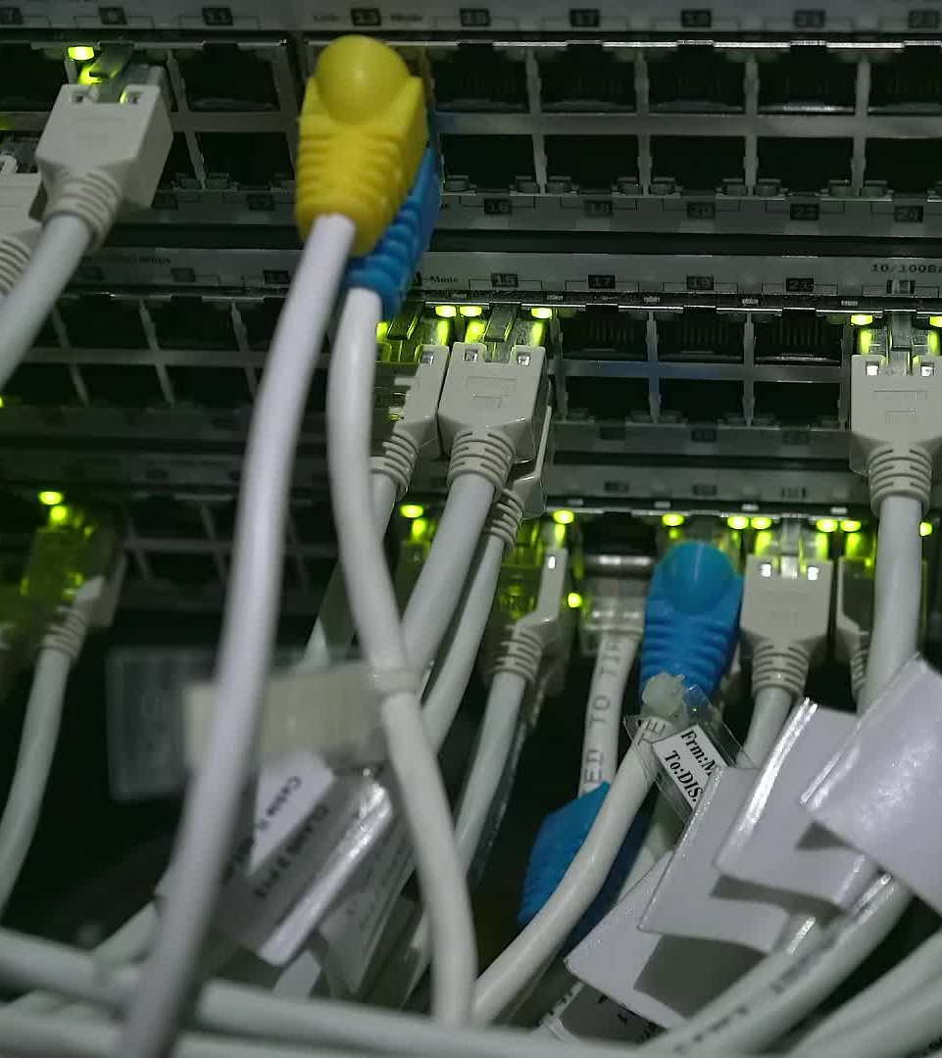
Objective
Using Python, Create a system which connects over a network linking .py files to each other, where the ‘server’ file can connect to multiple ‘client’ files, sequentially by network I/O.
This Prompts a communication where a user connected to the clients can communicate and be provided desired information.

Slide 4

What Layers Are Used?
Natively, unless prompted otherwise, socket programming using TCP and IPv4 to connected to each program.
TCP – Transmission Control Protocol , uses the Transport Layer
IPv4 – Internet Protocol version 4, which uses the Network Layer
Together these protocols dictate where the data is coming from, where it goes, and by what means the data is reaching both locations within the given instance

Slide 5
Workflow

Slide 6
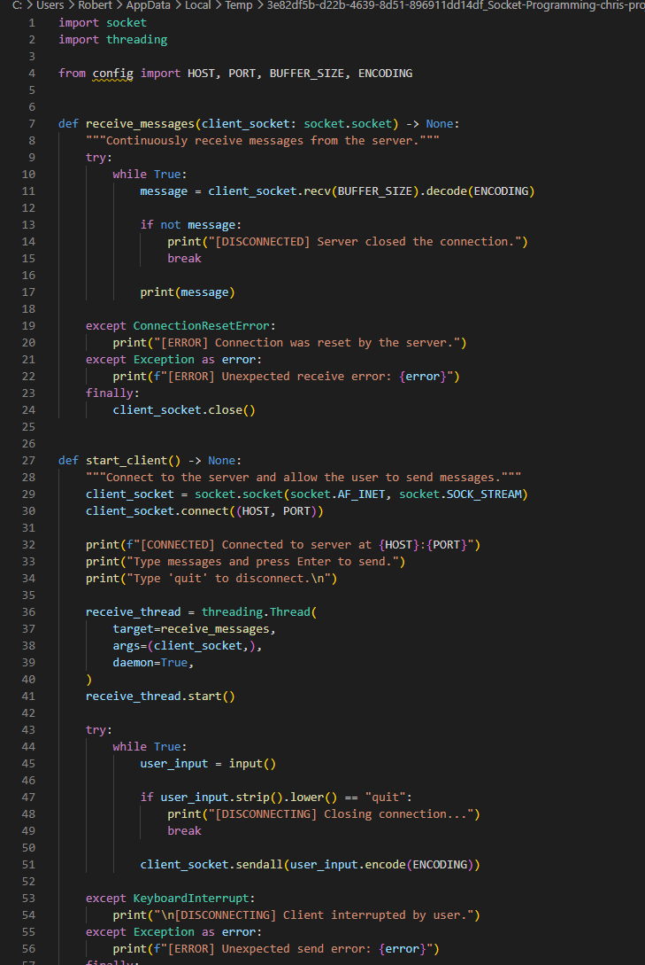
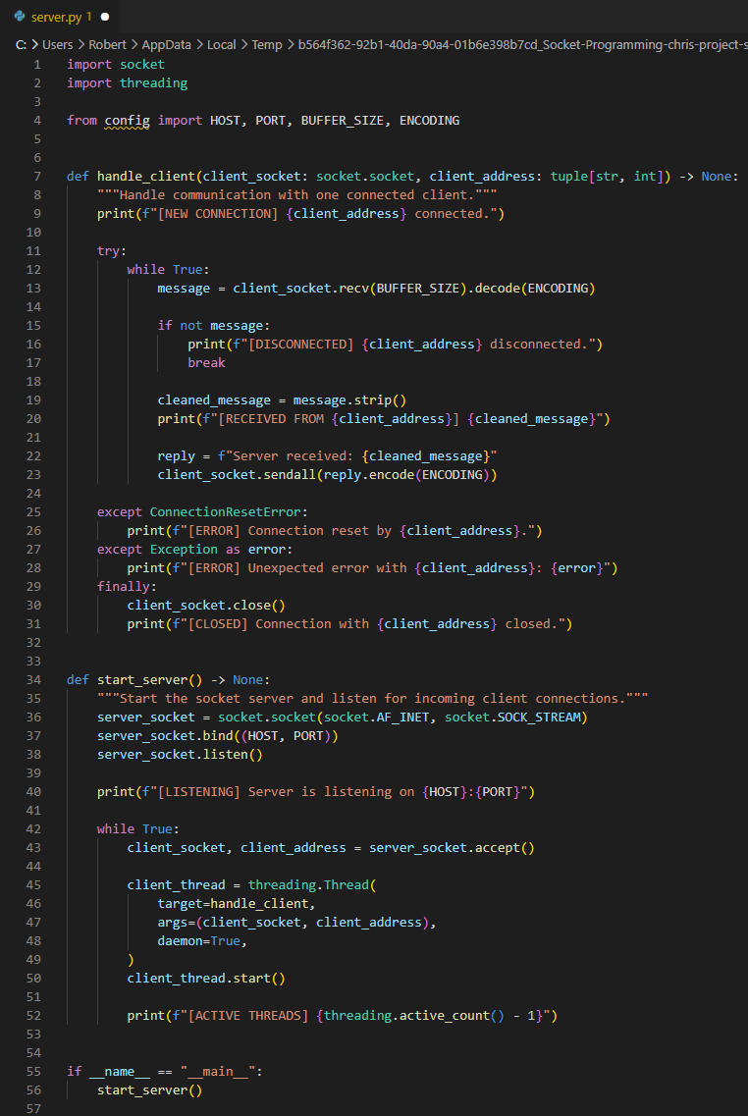
Source Code:

Slide 7
Output

